Slide 1
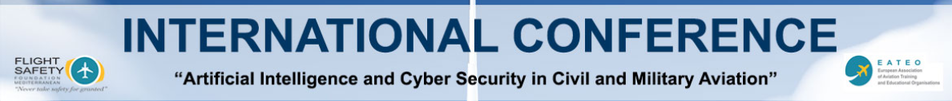
Artificial Intelligence for Applied Research in Civil Aviation
Dr Vassilis Kappatos
PhD, MEng, CEng, FWeldl, MIEEE, MISCM
Research Director,
Head of Sector C: Non-land Transport, Environmental and Economic Issues
Head of Constructural and Infrastructure Research in Maritime and Air Transport Lab
Hellenic Institute of Transport (HIT), Center for Research and Technology Hellas (CERTH)
President of the Hellenic Institute of Electric Vehicles (HELIEV)
Visiting Fellow
School of Aerospace, Transport and Manufacturing, Cranfield University
vkappatos@certh.gr / www.imet.gr
Larnaca, Cyprus 30th of May 2024

Slide 2
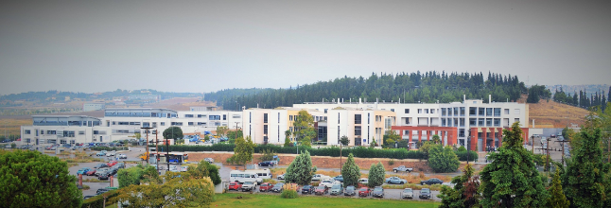
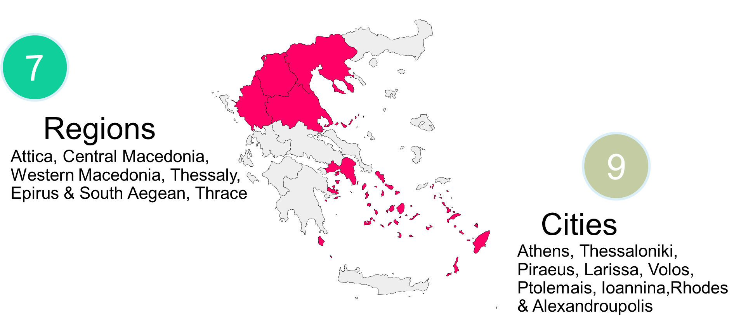
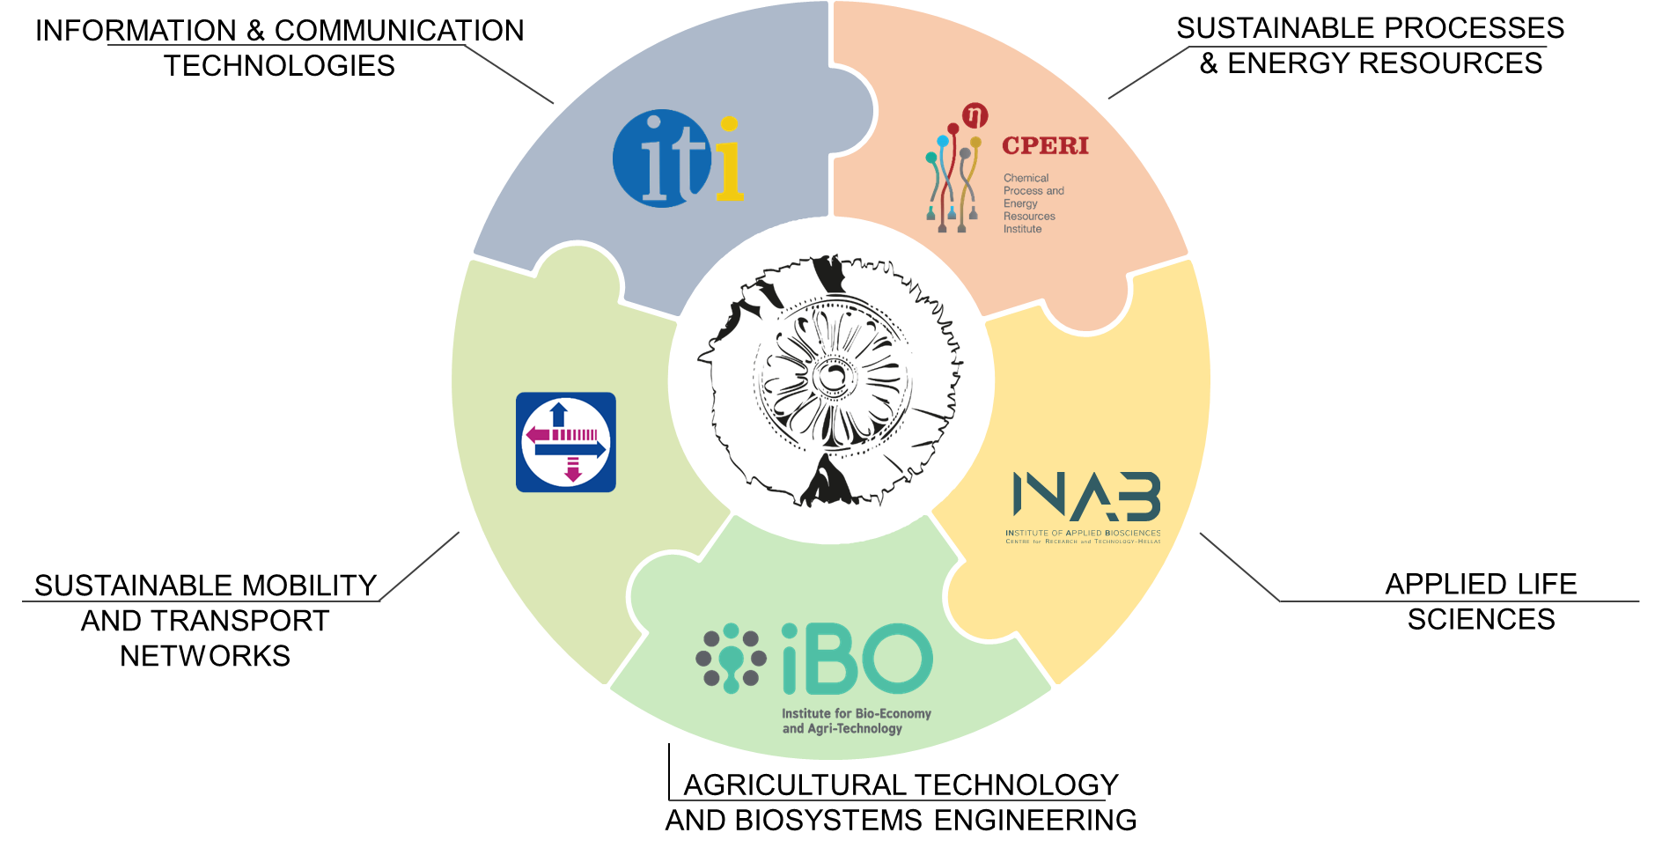
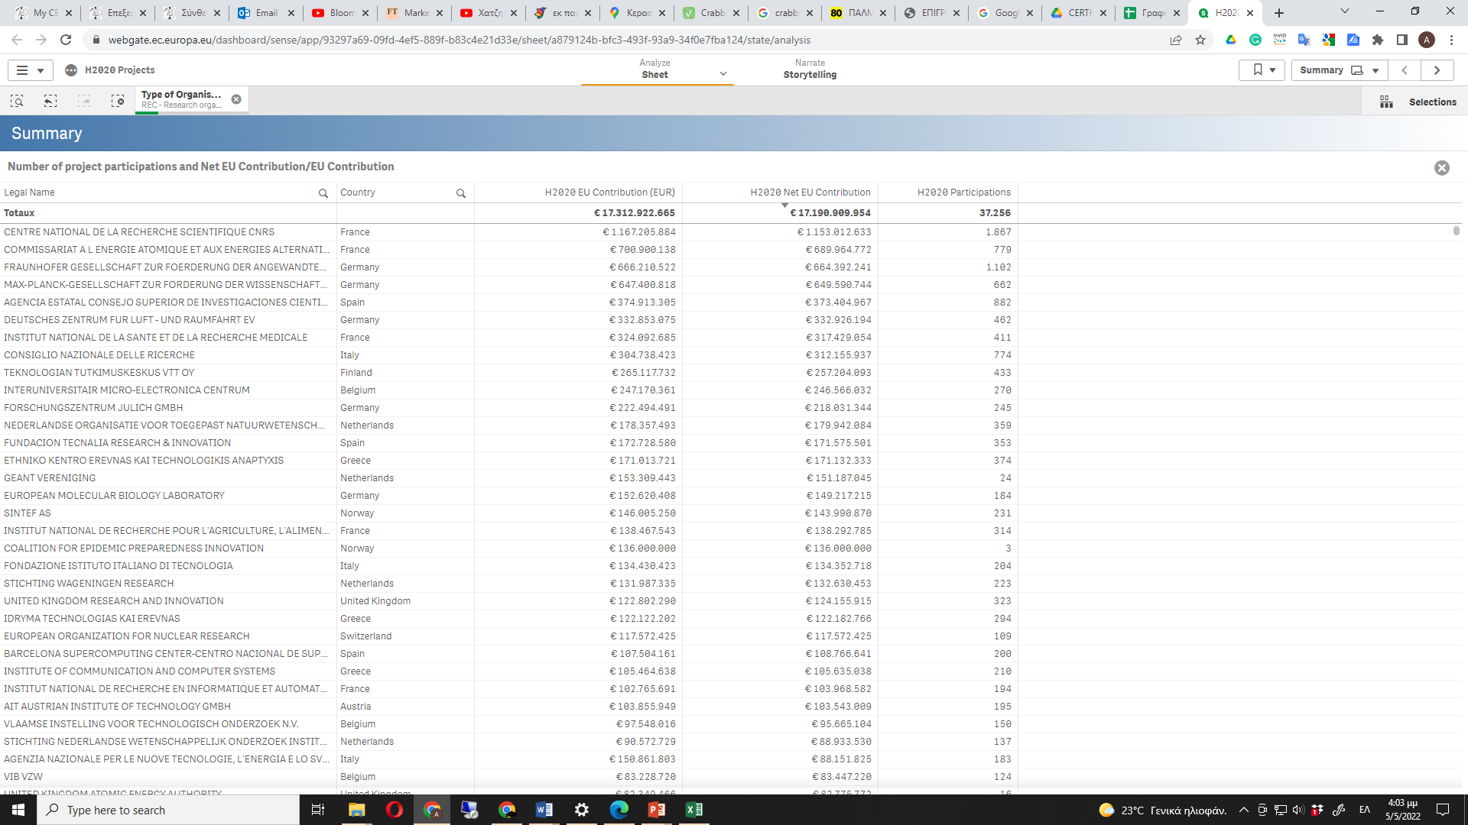
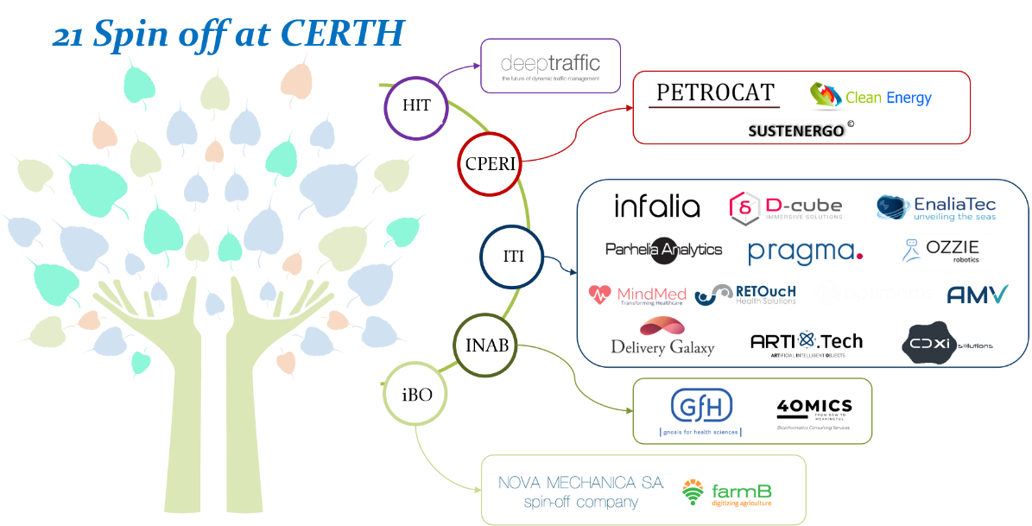
Centre for Research and Technology Hellas
(CERTH)
Personnel: >1625.
Annual Revenues: > 65,8 M€ (3 year average).
  77% from competitive research projects.
  10% from government institutional funding.
  13% from bilateral industrial research contracts.
TOP-14 among the EU Research Centers
Notes:
Έτη 2020,2021,2022

Slide 3
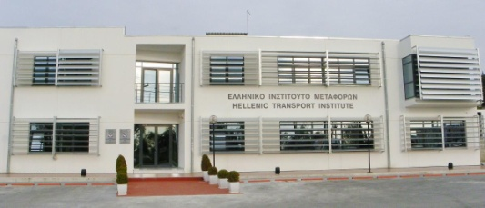
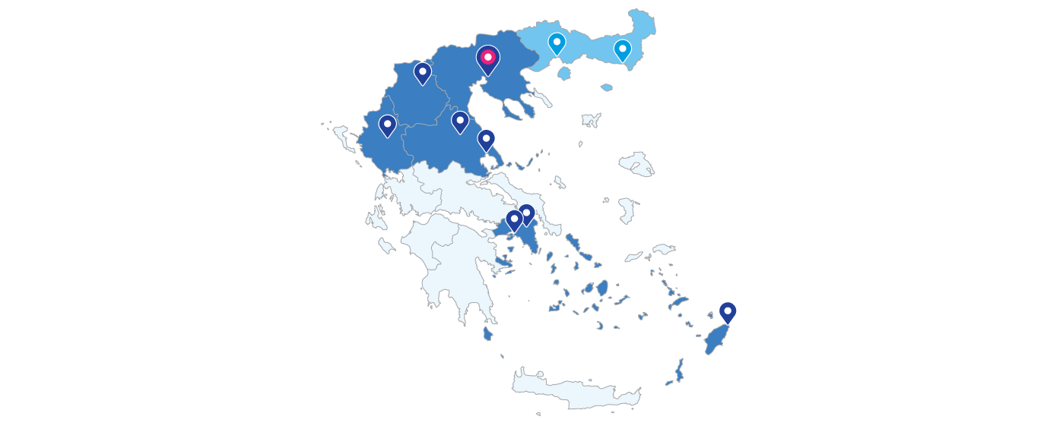
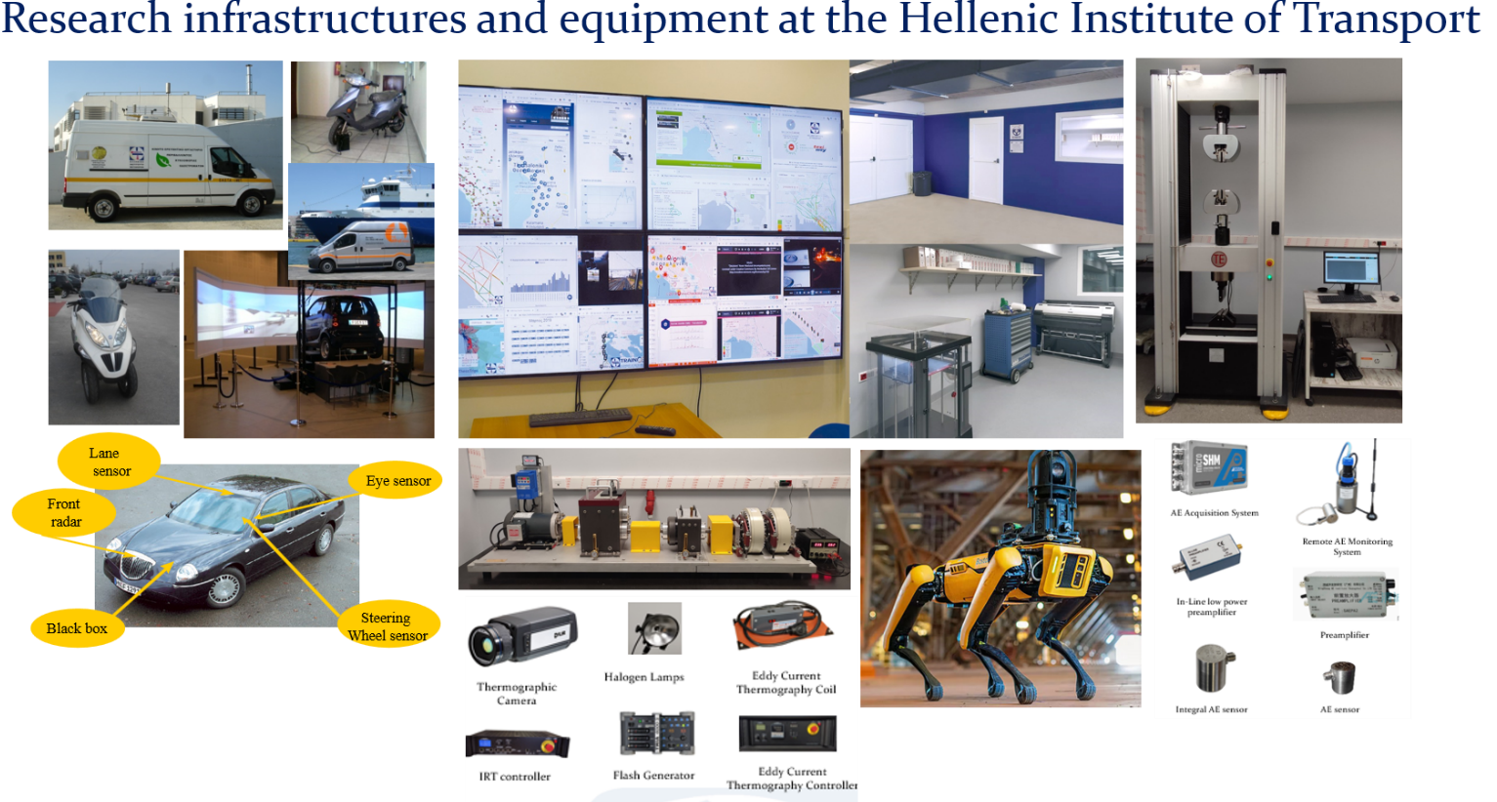
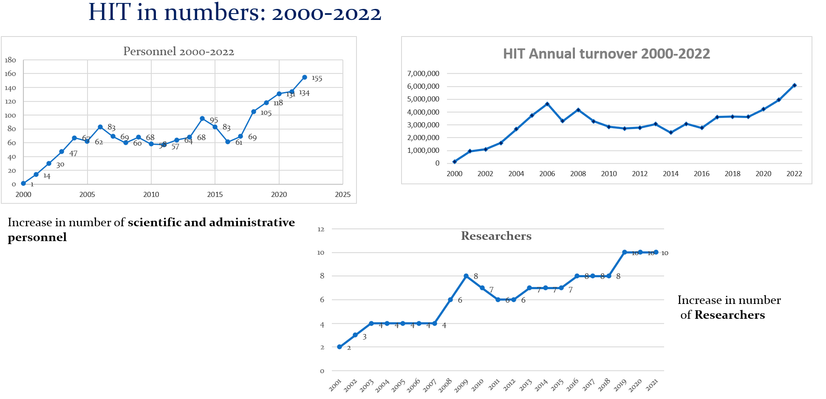
Hellenic Institute of Transport (HIT)
HIT is the main Transport research Organisation of Greece.
Primary objectives, to:
  Promote and conduct advanced research in the Transport field.
  Support the decision making process at government level.
  Disseminate research results and support innovation.
6
HIT headquarters and branches
Attica, Central Macedonia, Western Macedonia, Thessaly, Epirus and S. Aegean
Under development: Eastern Macedonia-Thrace

Slide 4
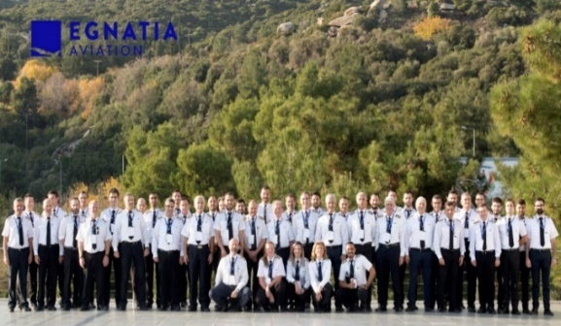
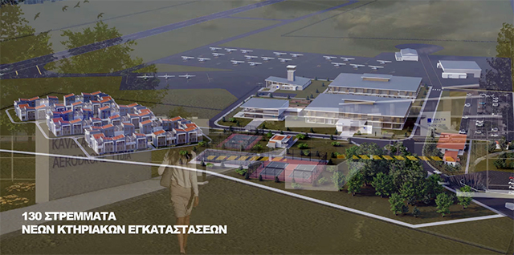
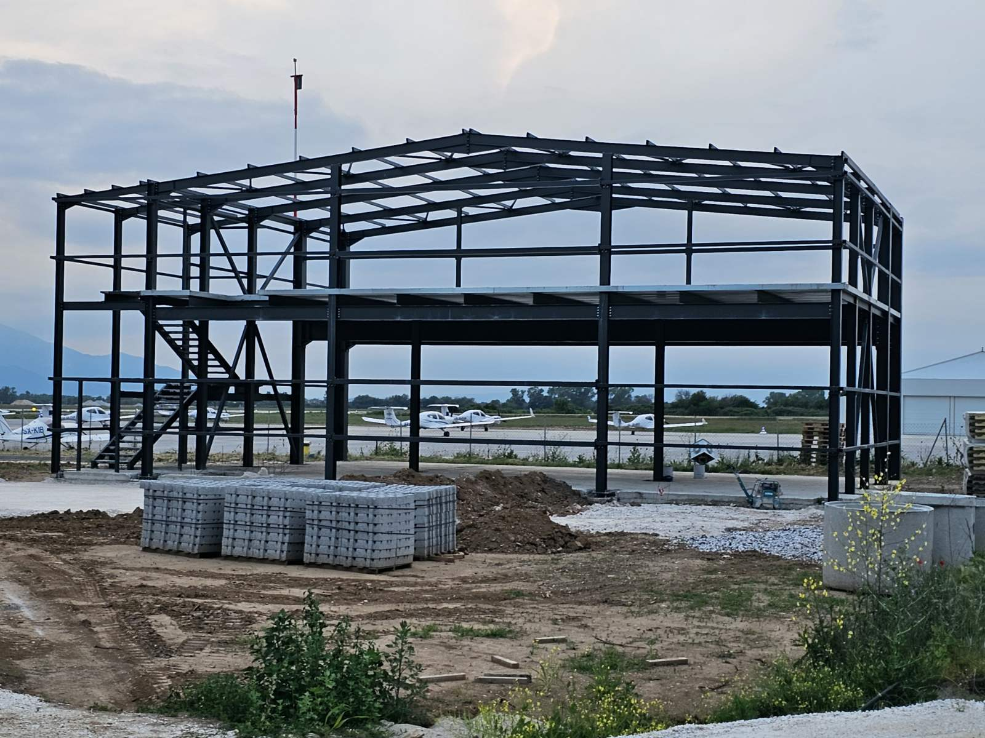
IMET branch (AVIATION) at Lydia Airport of Kavala
Egnatia Aviation (ΕΑ)
Trained >2,500 pilots from >57 countries, >65% are international students.
>50 airlines: Airlines: Aegean, Olympic, Wizz, Ryanair, Qatar…
"Lydia" Airport is the first privately owned, General Aviation Airport in Greece.
Lydia is located on the site of the former military airport of Amygdaleonas, approximately 5 km from Kavala
  18 training aircrafts.
  40-year leasing of land.
Airport services
  Training (all disciplines).
  Firemen.
  Flight attendants.
  Maintenance etc.
HIT/CERTH acquires its Aviation Branch at the facilities of the newly constructed Lydia Airport, developed by EA with a budget of 14 million euros.
Cooperation HIT – EA.
Τhe research capabilities and laboratory infrastructure of HIT/CERTH are significantly enhanced.
We focus on collaborative research and training activities in the field of aviation and safety.

Slide 5


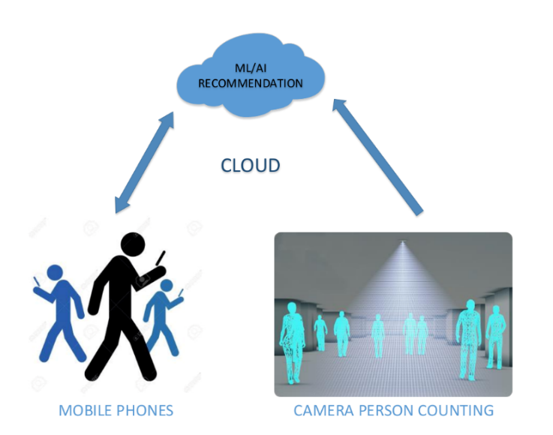
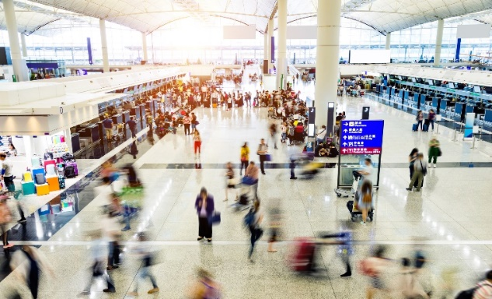
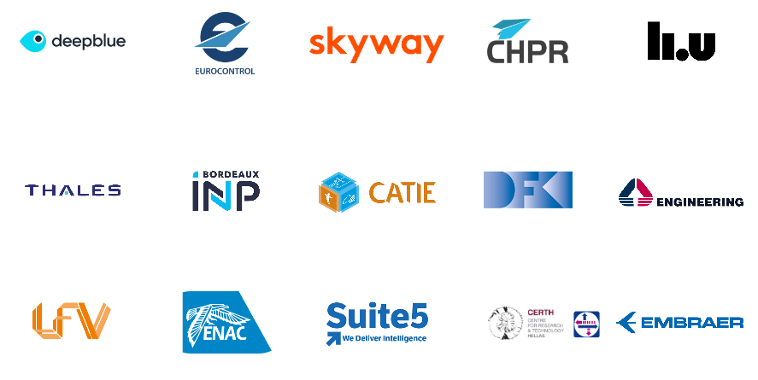

HAIKU project
Main objectives
Delivering truly human-centred AI-based Intelligent assistant prototypes capable of integrating human values, needs, capabilities and limitations.
Intelligent assistants that dynamically learn from human users and continuously evolve over time.
Evaluate how technology can facilitate human activities and ultimately improve safety.
Title: Human AI teaming knowledge and understanding for aviation safety
Duration: 36 months
Budget: 6.624.322€ (CERTH 503.750€)
Partners: CERTH, EUROCONTROL, DEEP BLUE, SKYWAY, CHPR, II.U, THALES, CATIE, DFK, LFV, ENAC, SUITE5, EMBRAER, BORDEAUX INP, ENGINEERING INGEGNERIA INFORMATICA
Project coordinator: DEEP BLUE

Slide 6
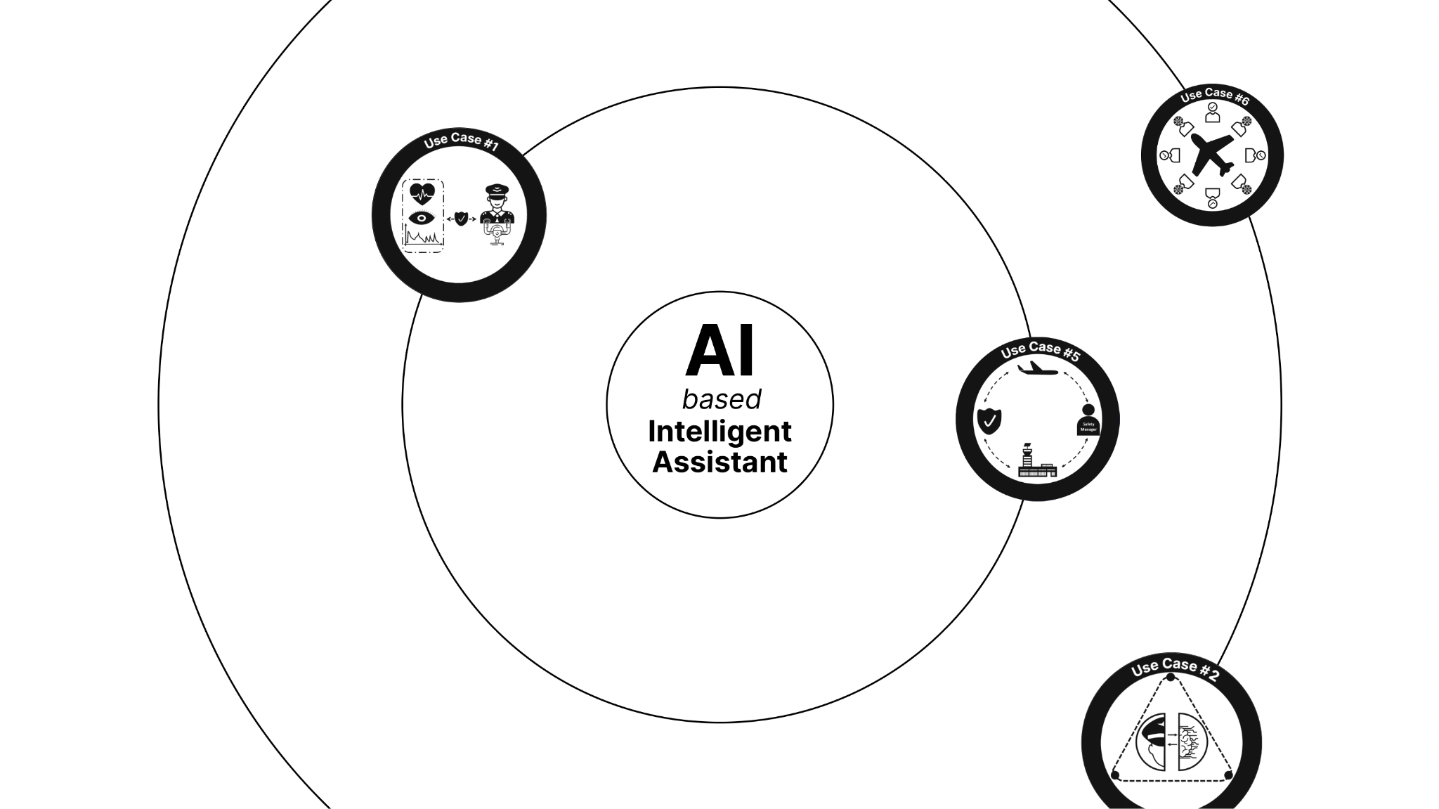
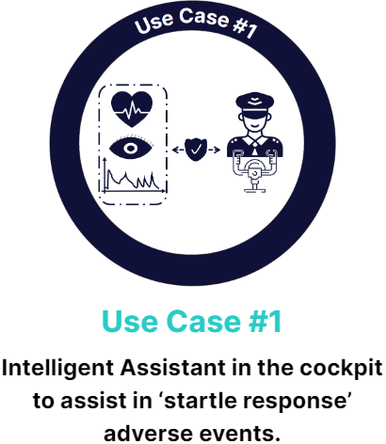
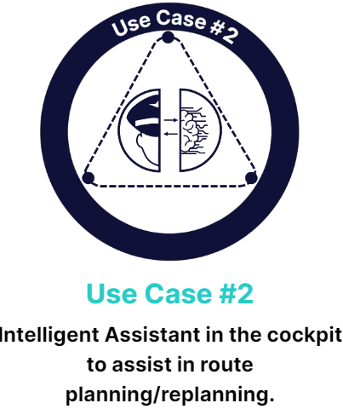
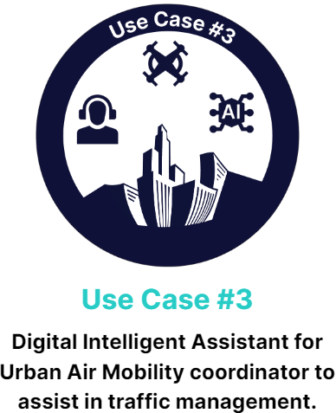
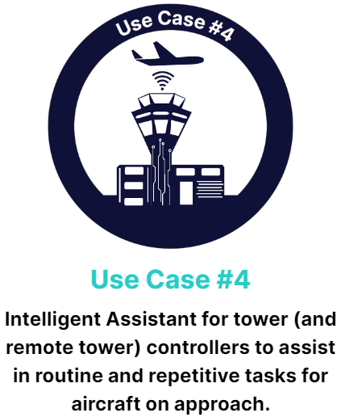
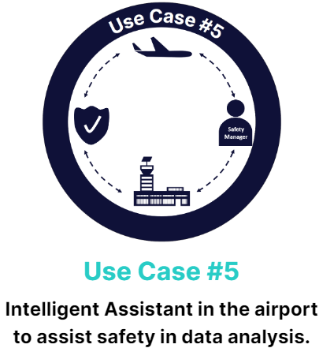
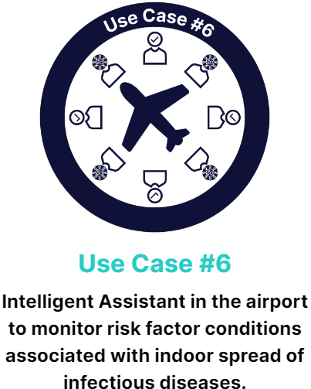
HAIKU project
Use Cases
The HAIKU project aims to pave the way for human-centric Artificial Intelligence in aviation. It explores the potential for AI applications through six different use cases, which each seek to deliver AI-based Intelligent Assistant prototypes.

Slide 7
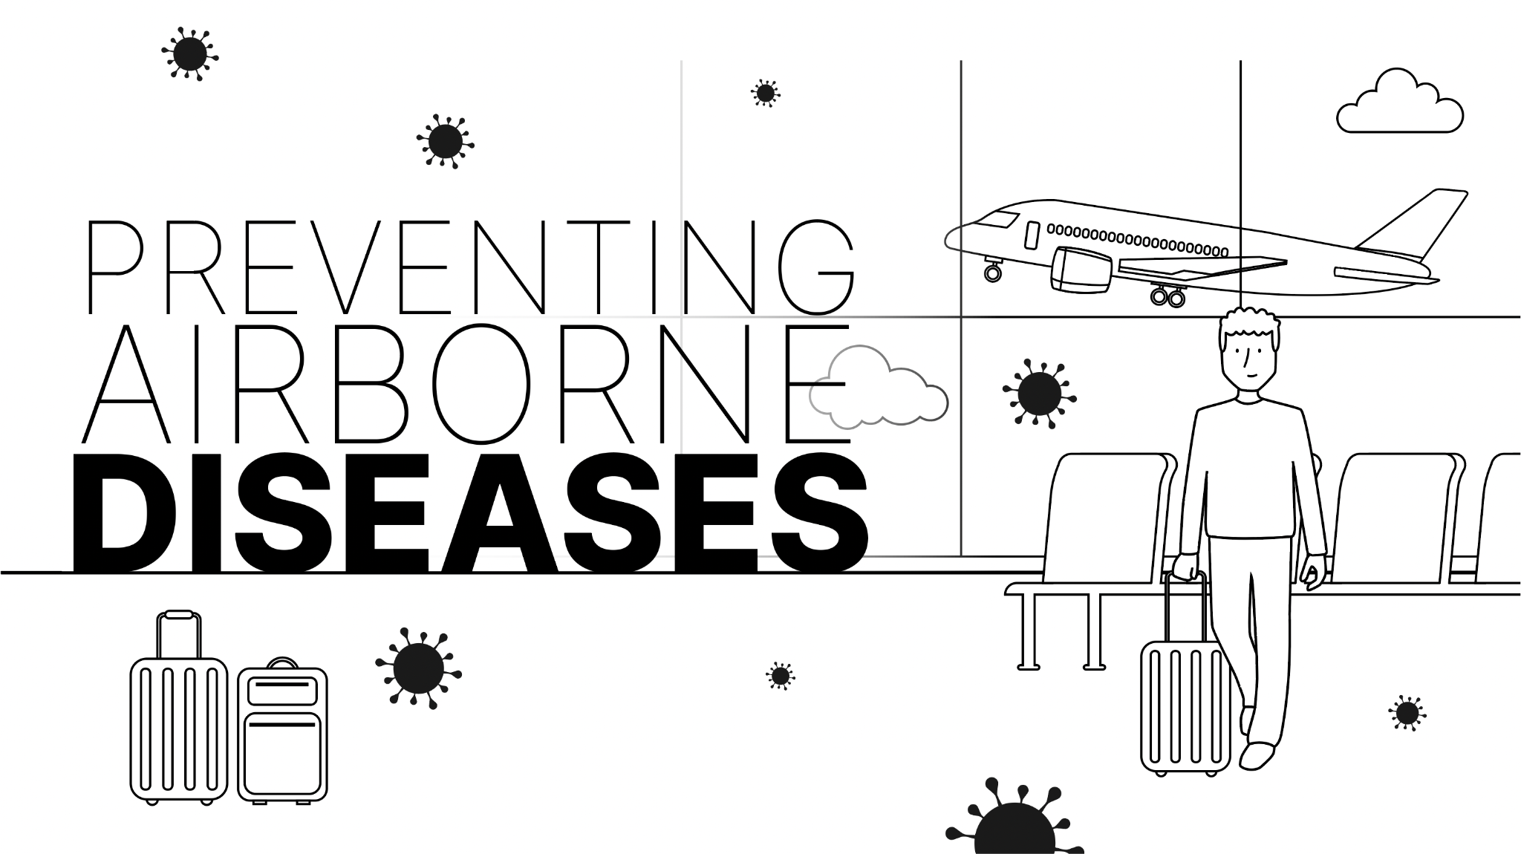
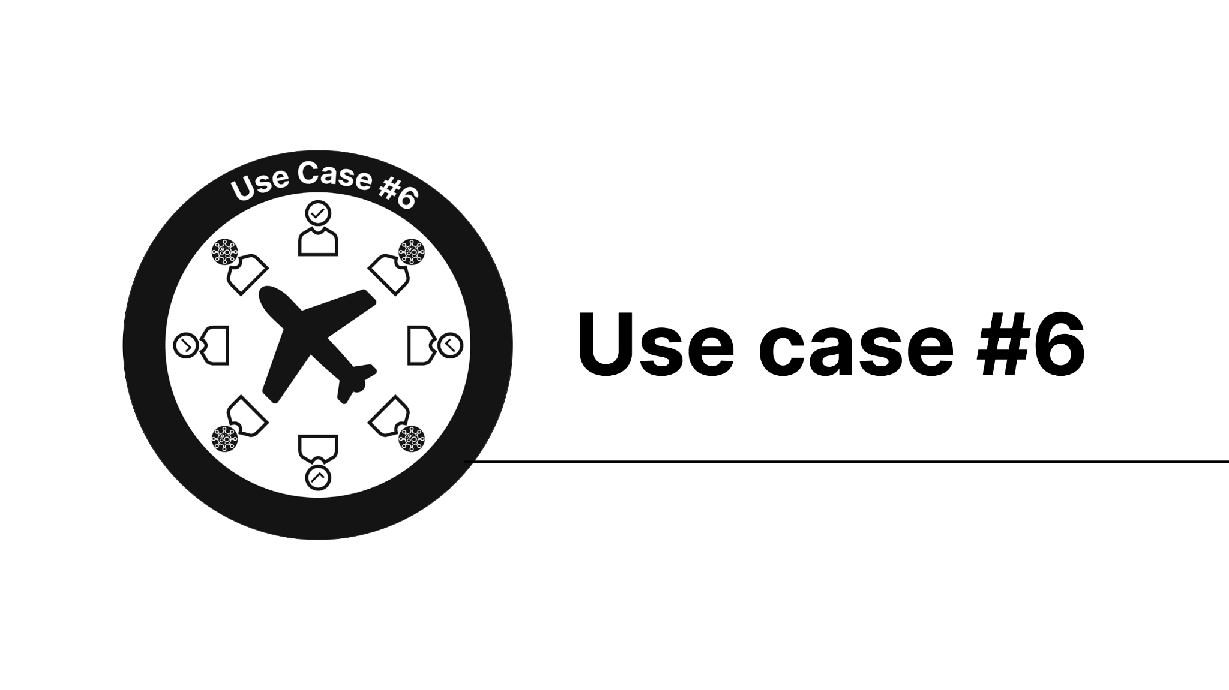
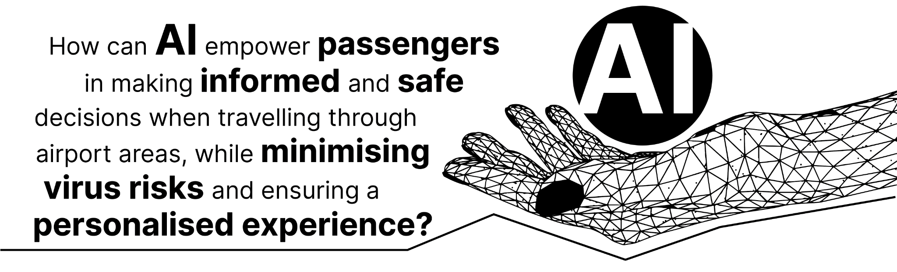
HAIKU project
Use Cases #6

Slide 8
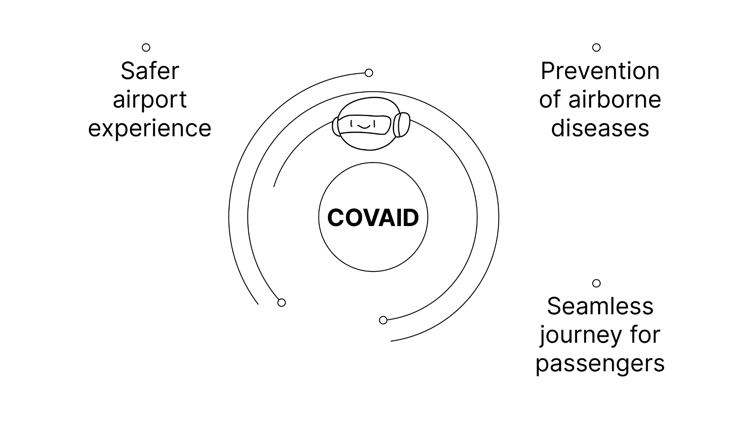
HAIKU project
COVAID
COVAID, a key asset for passengers at the airport:
it ensures a safer and more informed airport experience, prevents airborne diseases and promotes a seamless journey for all passengers.

Slide 9
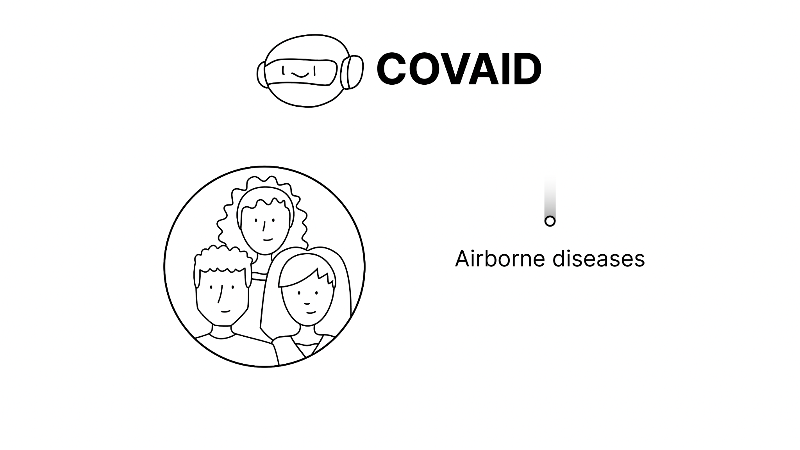
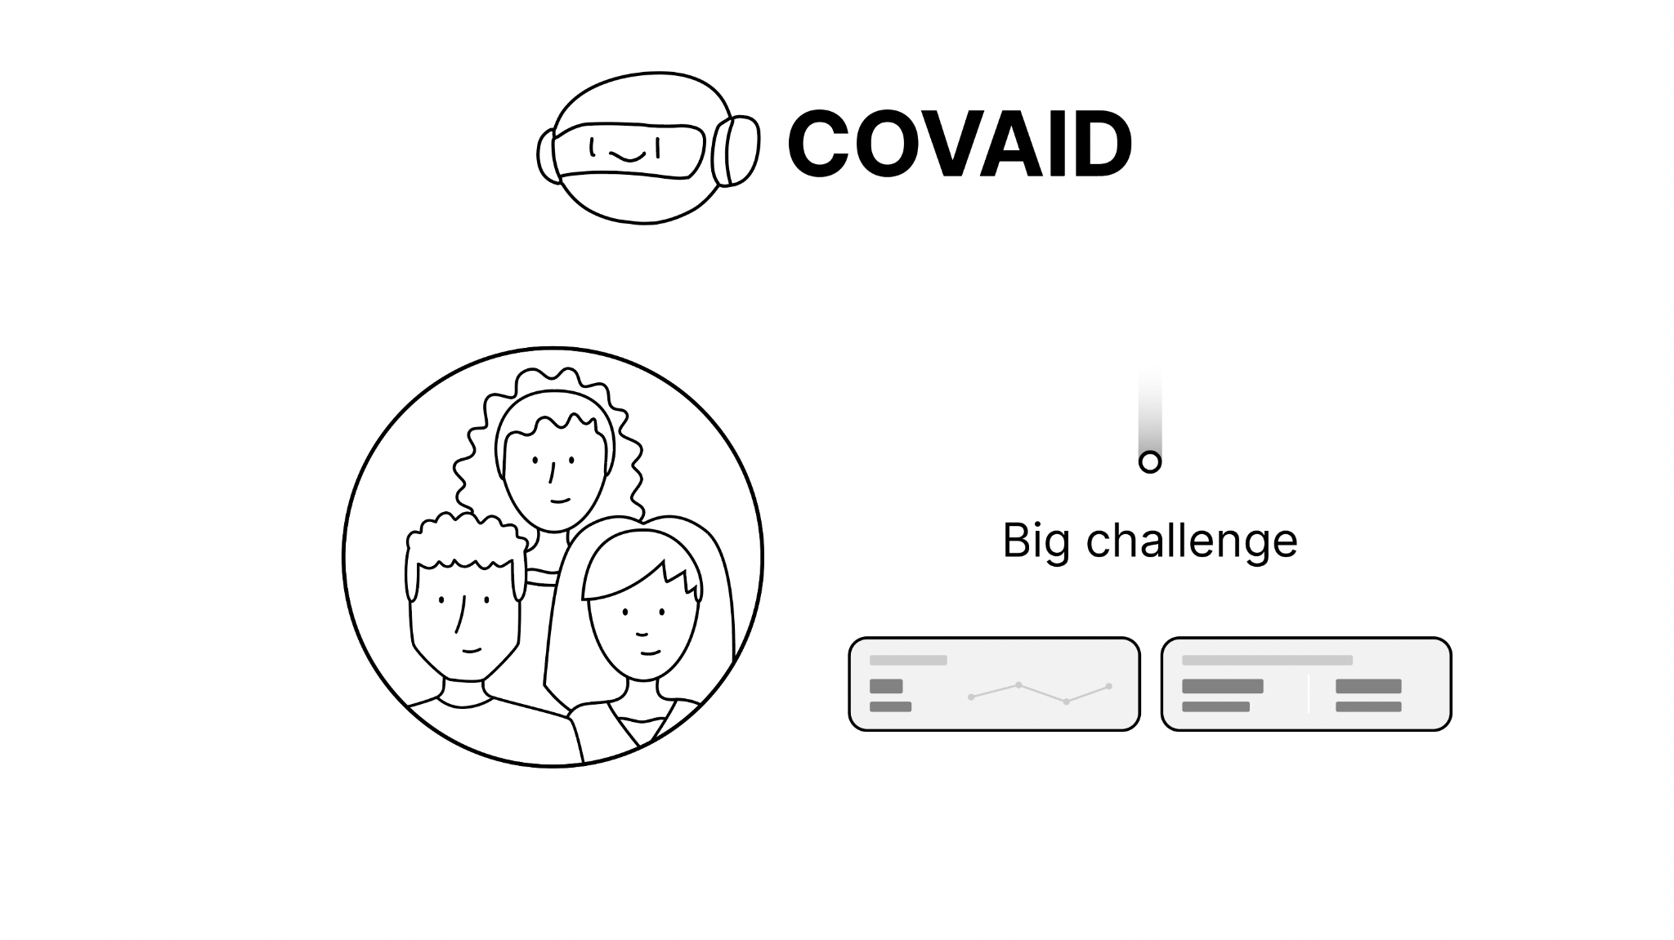
HAIKU project
Intelligent Assistant
COVAID is an Intelligent Assistant for passengers which aims to tackle the critical issue of preventing the spread of airborne diseases in crowded areas, specifically airports.
Spread οf Diseases
They are crowded indoor spaces, and thus the spread of infectious diseases (such as COVID 19) is a big challenge.

Slide 10
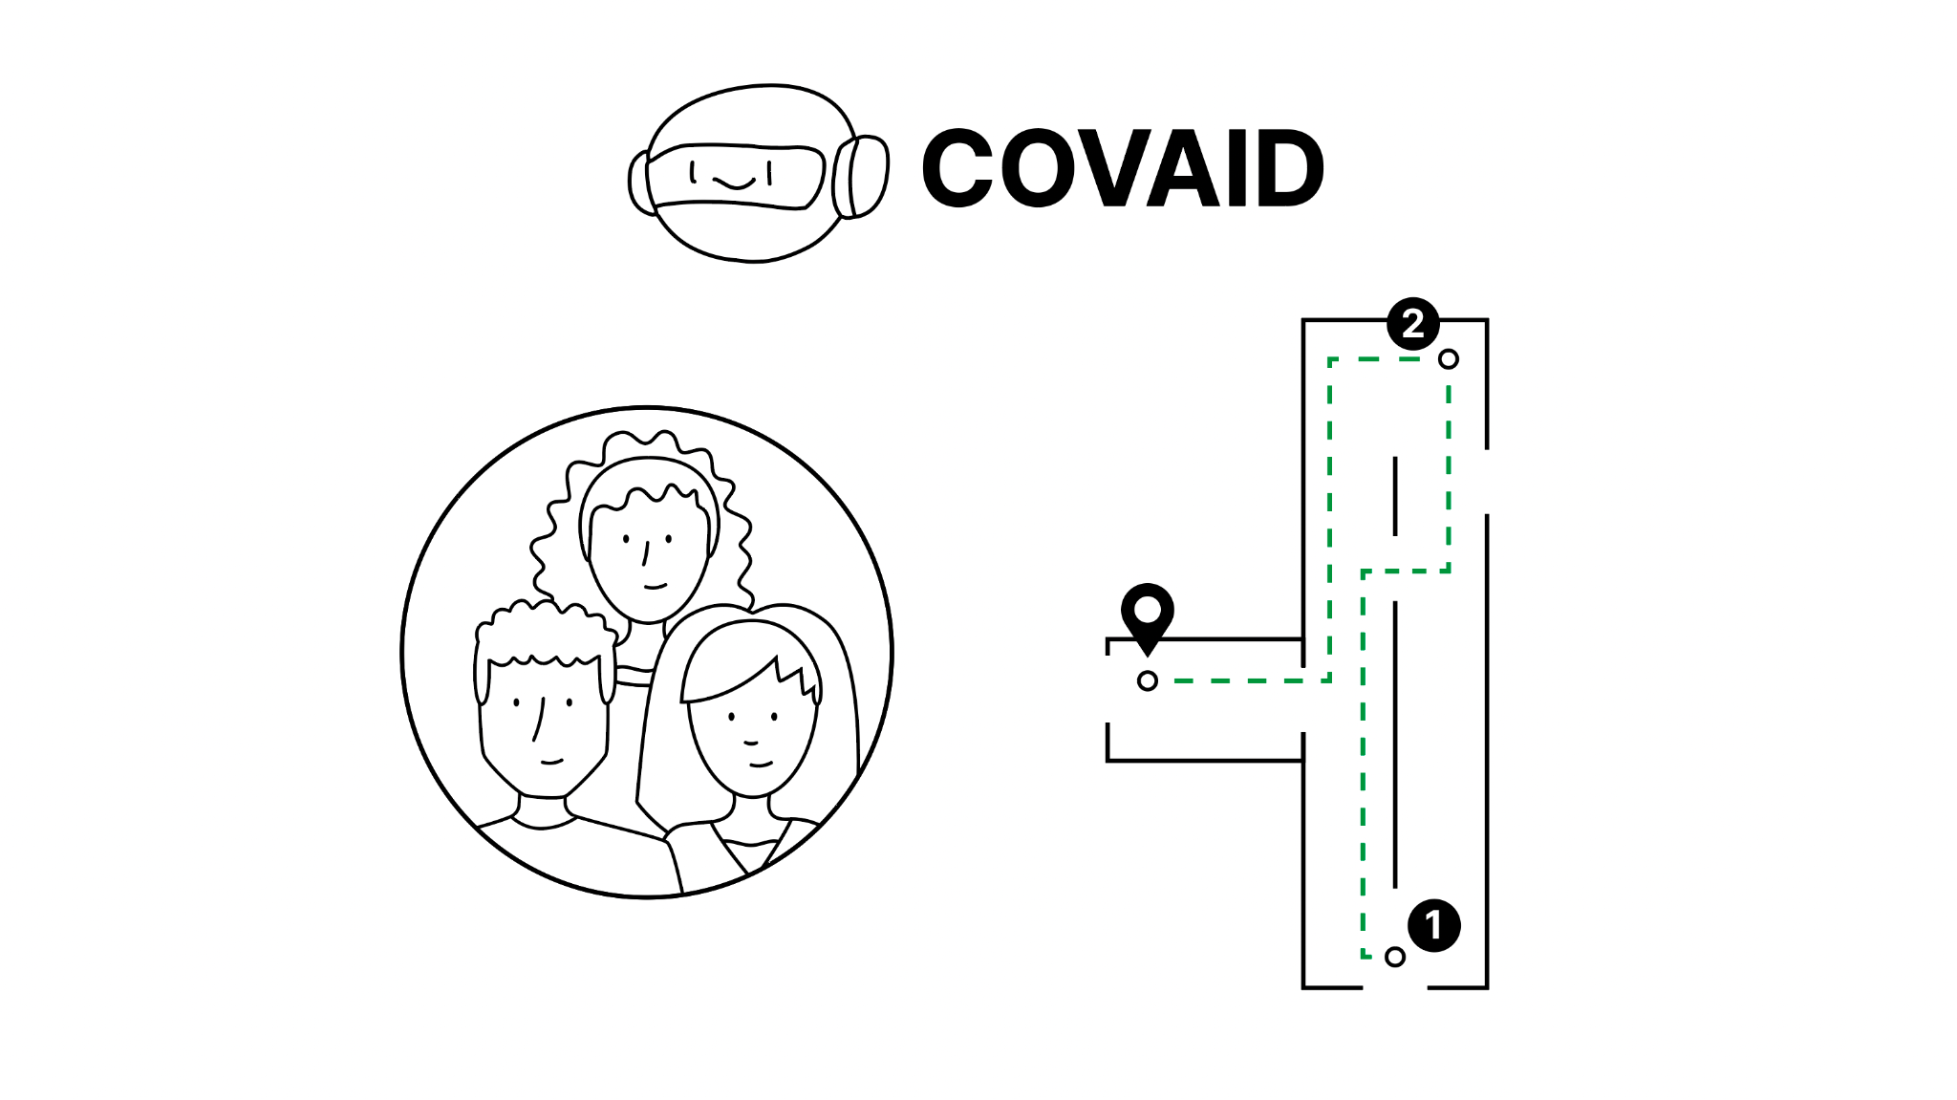
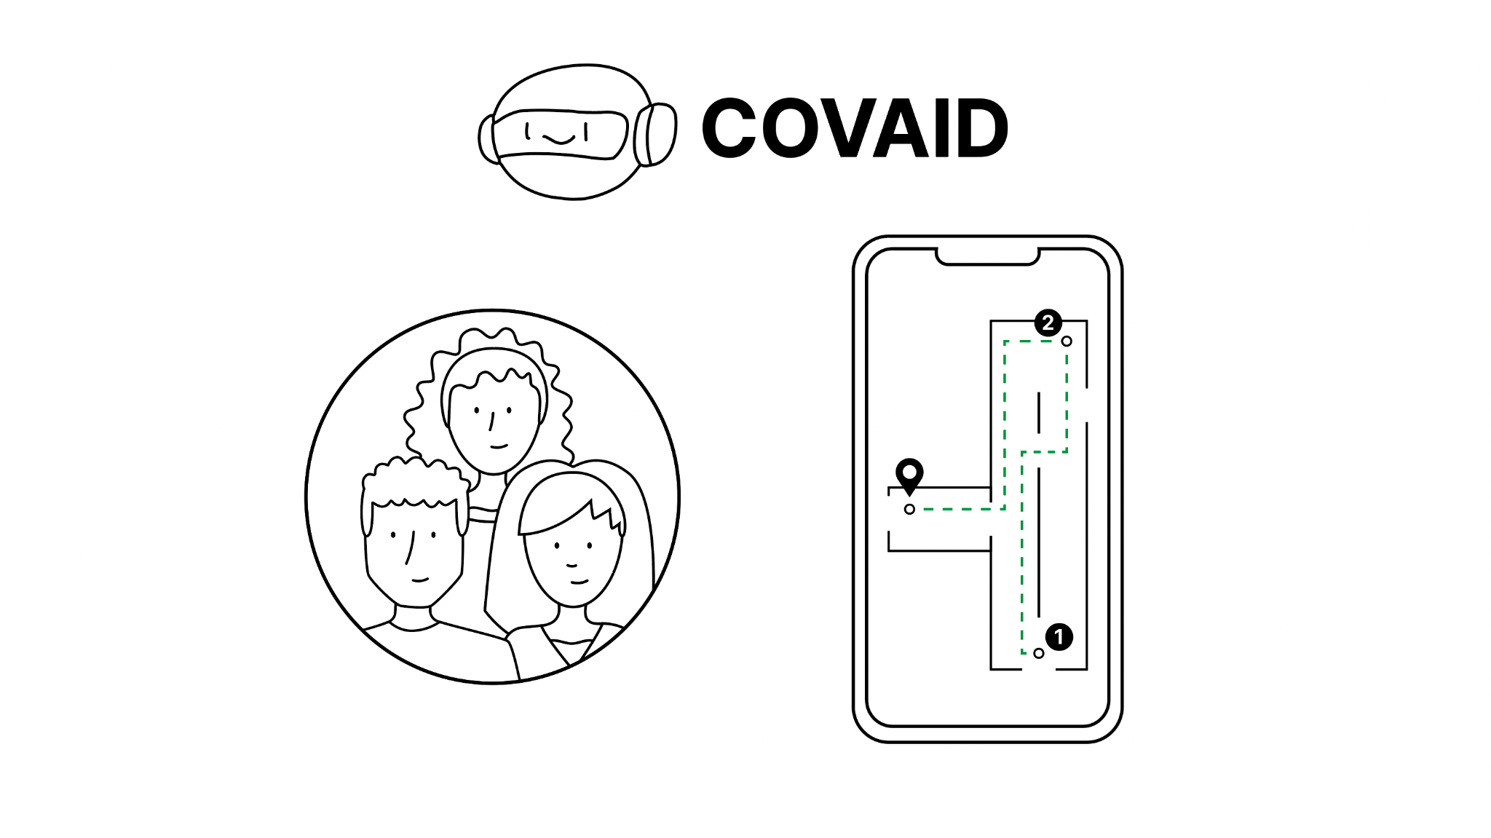
HAIKU project
Smart Routing
To address this problem, the assistant uses a real-time routing recommendation system powered by machine learning to aid passengers in avoiding overcrowded areas.
Smartphone Apps
The passengers can simply download an app on their smartphones, and use it to customize their experience.

Slide 11
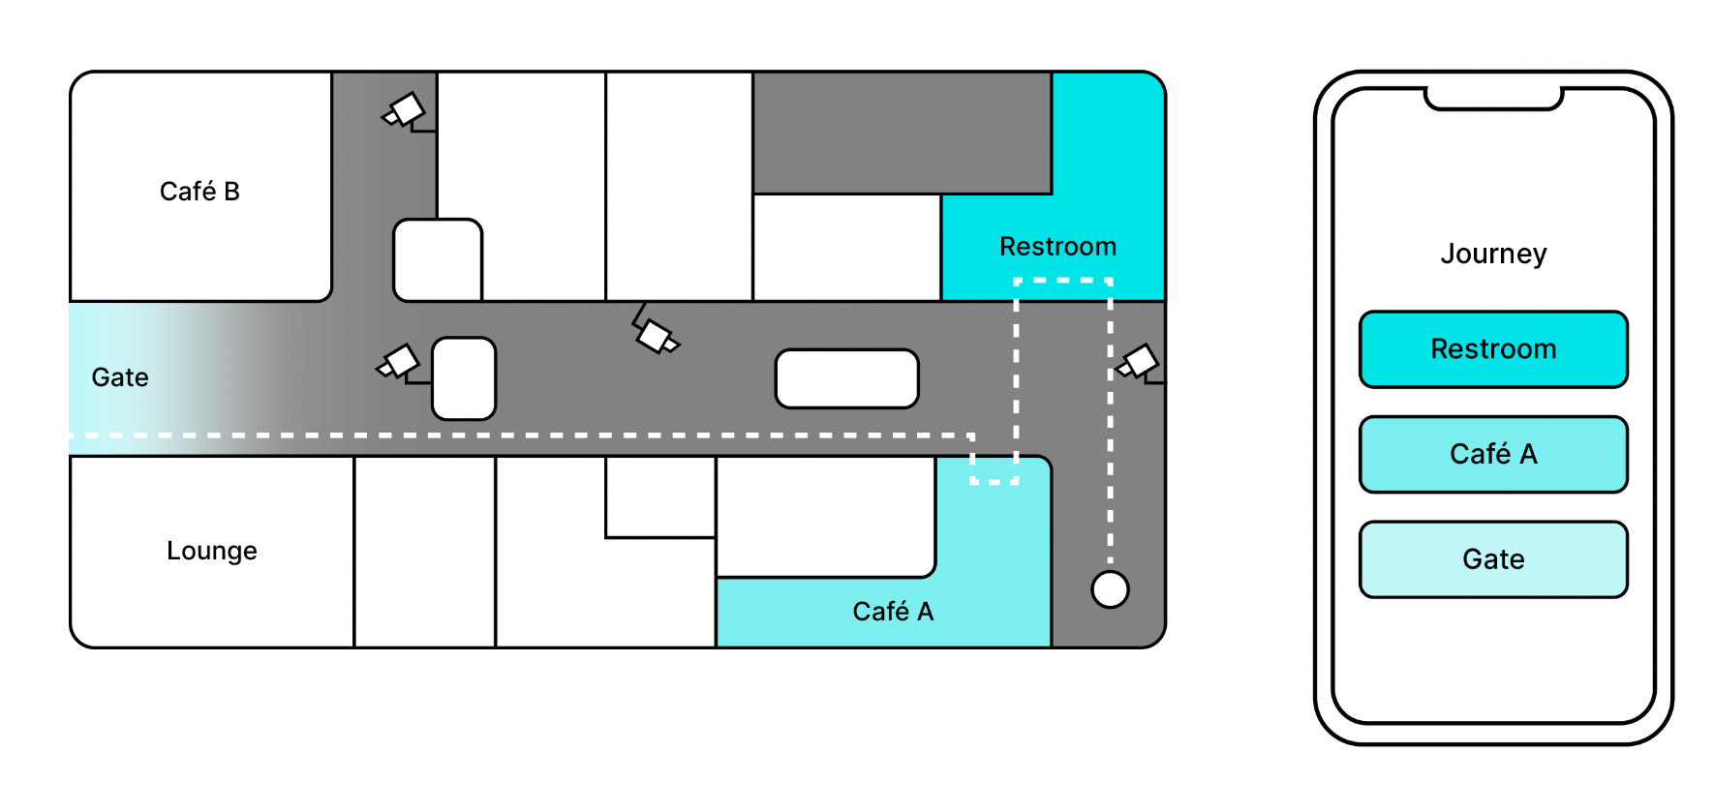
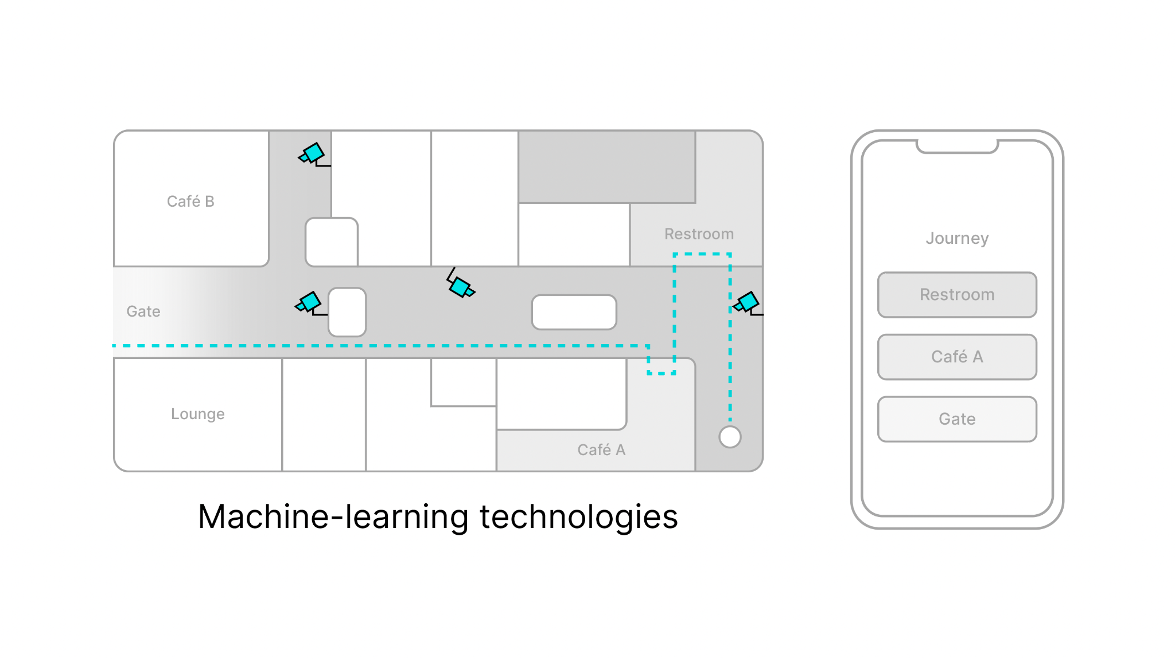
HAIKU project
Personalized Airport Guide
The passengers open the COVAID app that is going to support his journey through all airport areas, from check-in to the gate, offering a personalised experience. The passengers set their preferences and intentions, such as going to the closest restroom, getting a coffee or relaxing in the lounge next to the gate.
Guidance (1)
Accordingly, COVAID leverages machine-learning technologies to analyse the airport's camera sensors data, predict the busiest areas, and then recommend the safest path to reach.

Slide 12
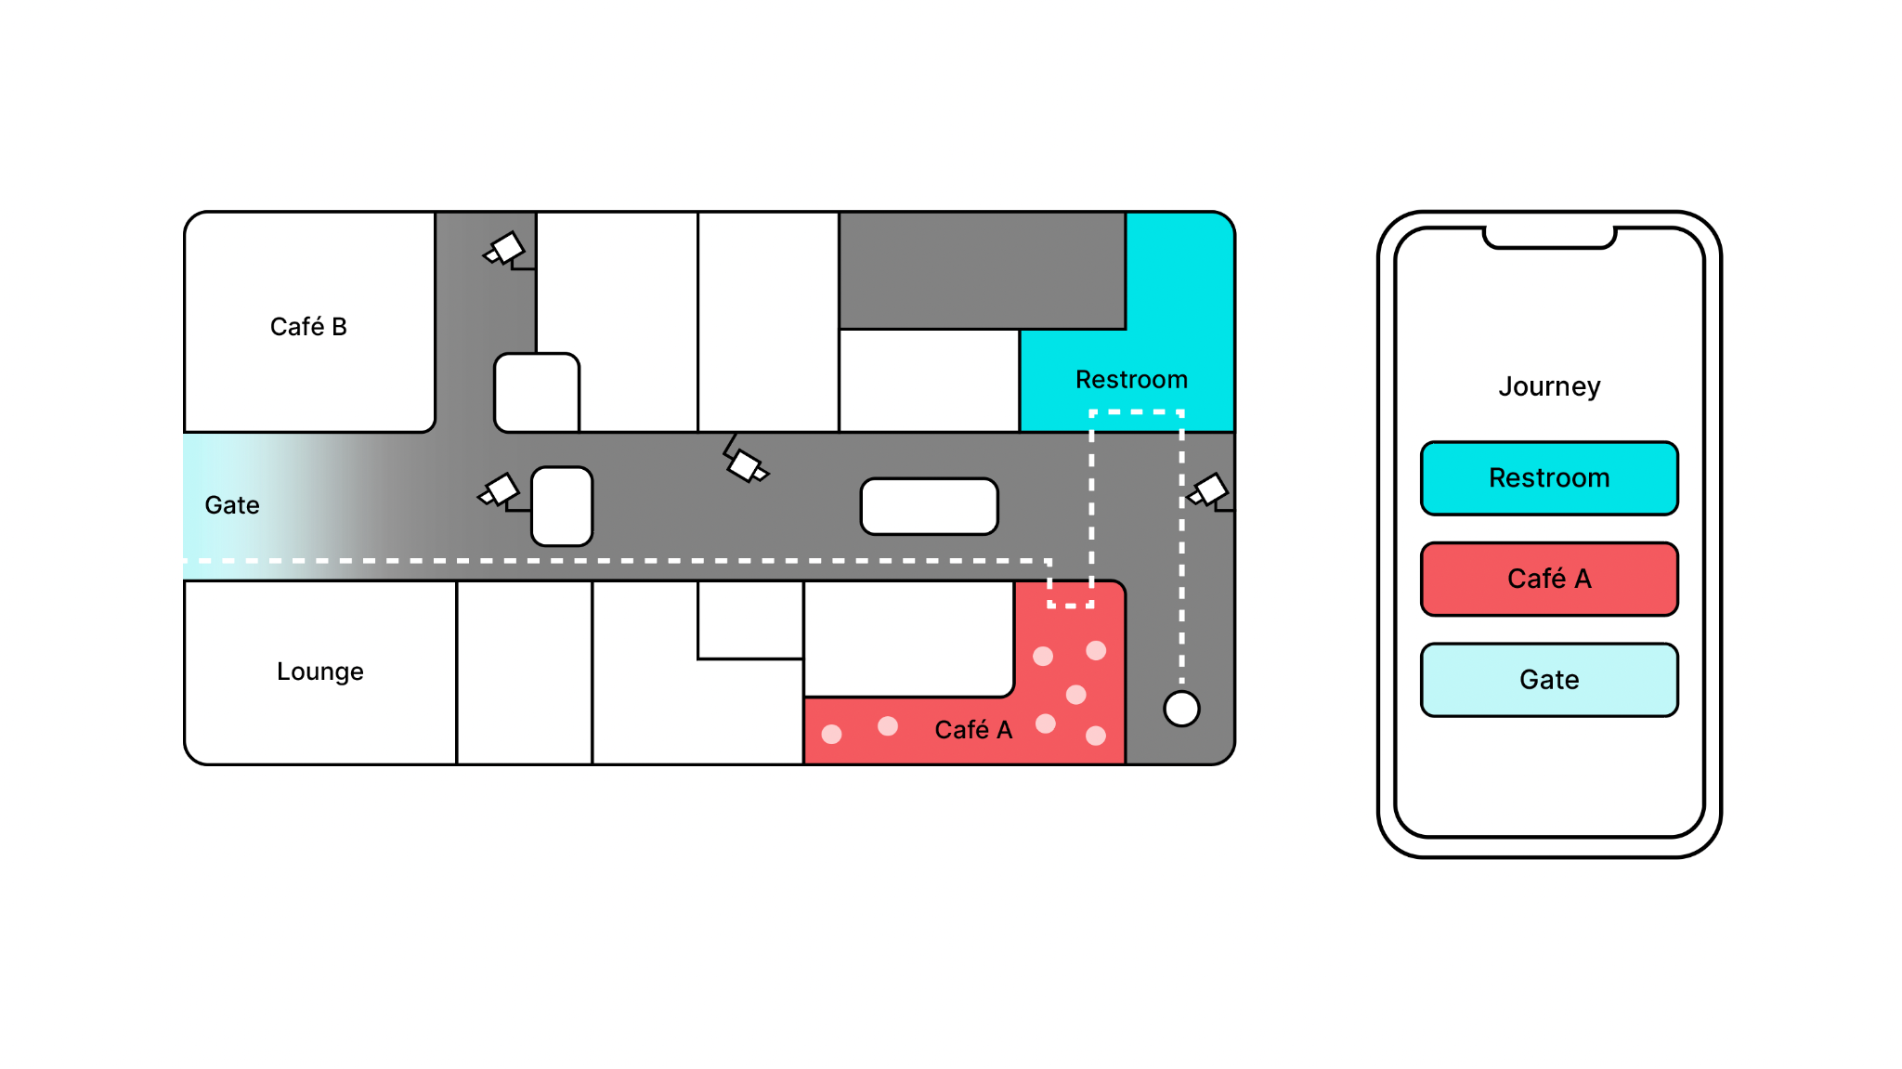
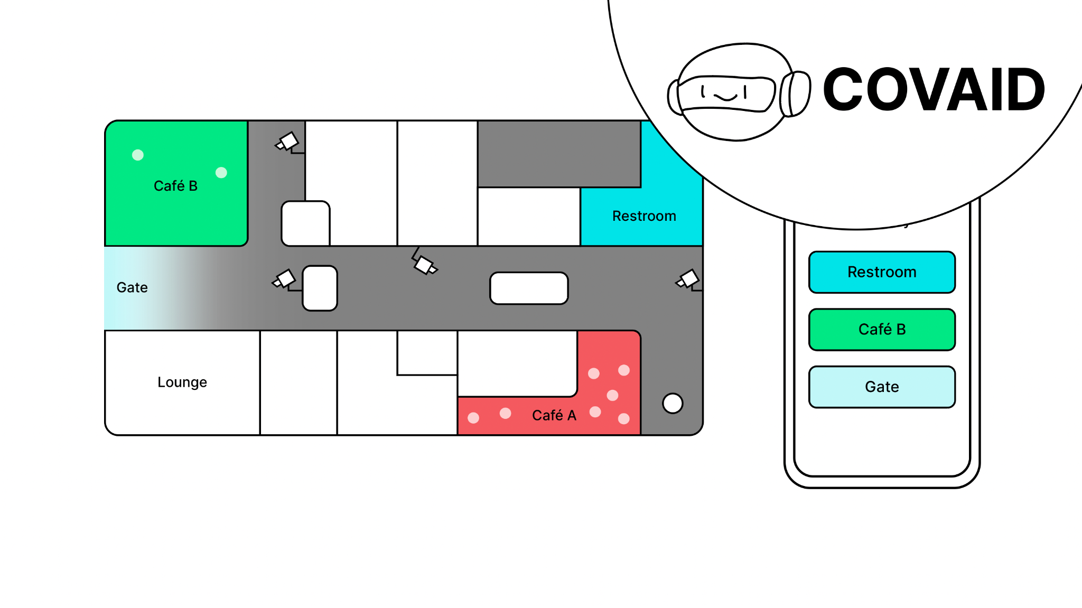
HAIKU project
Guidance (2)
In fact, the passengers want to have breakfast before the flight. The café next to them seem too busy…The café next to passenger (the white dot at the bottom right of the map) turns red and several white dots appear, indicating that the place is crowded. The corresponding rectangle on the smartphone also turns red.
The assistant points him to the least crowded one a few minutes away from where he is standing… The least crowded café recommended by the assistant is coloured green. The corresponding rectangle on the smartphone also turns green.

Slide 13
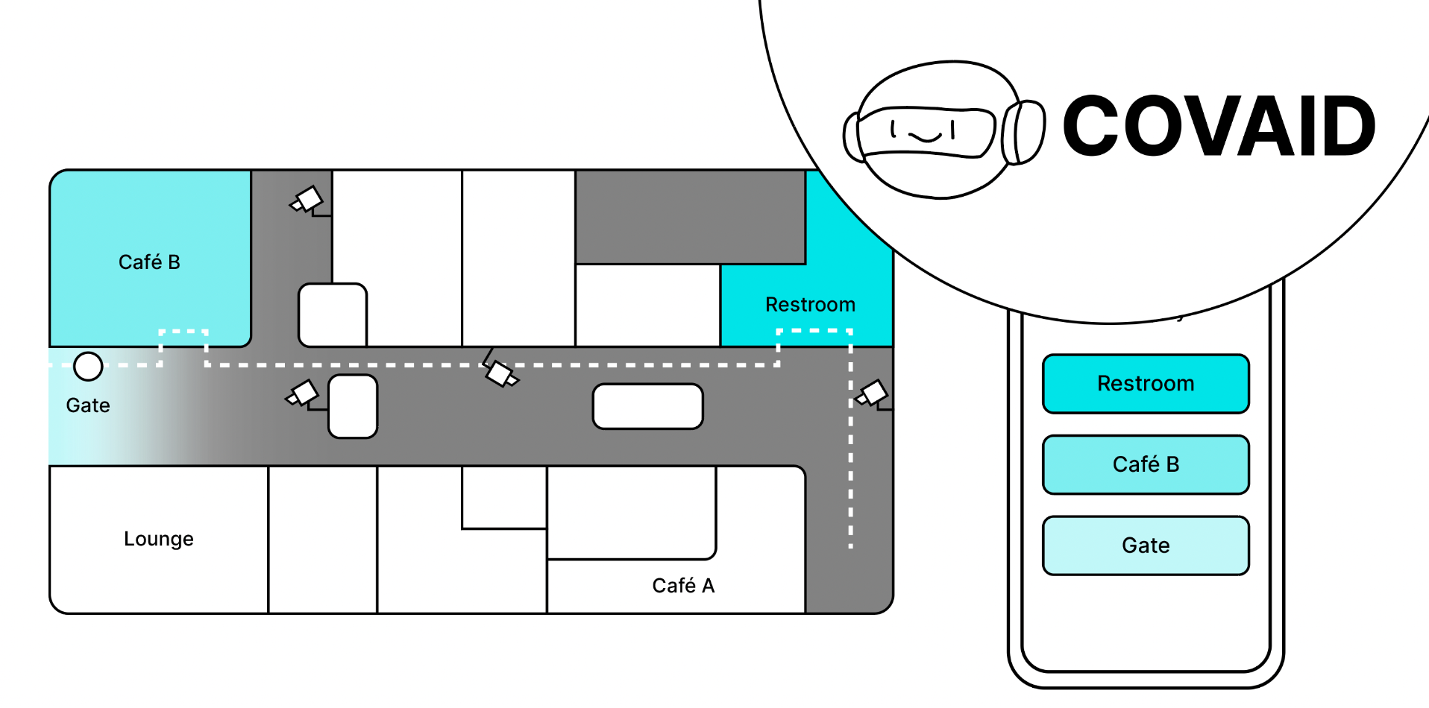
HAIKU project
Guidance (3)
So passengers go there, relaxes a bit before the flight, avoiding unnecessary contacts. As passengers decide to follow the AI's advice, the colour green becomes blue. A new path is formed on the map and the dot (representing James) moves along it.

Slide 14
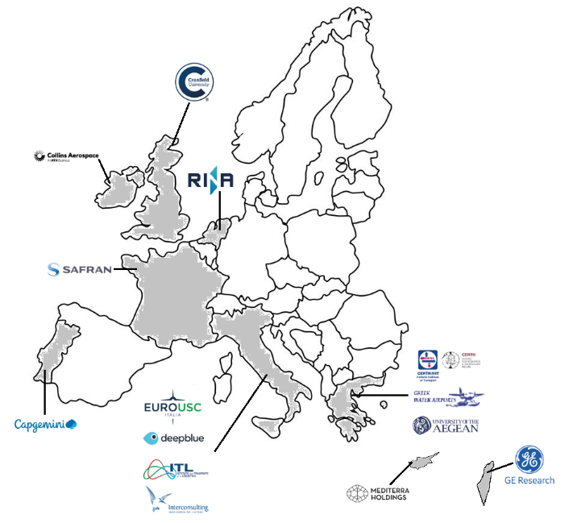
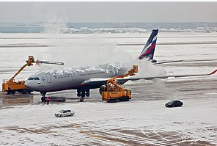
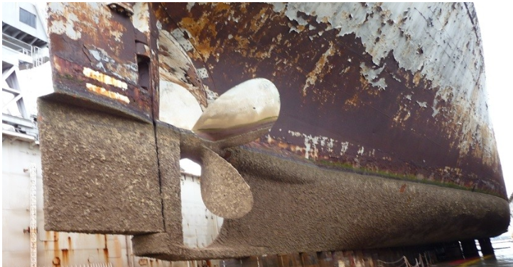









Di-Pegasus project
Main objectives
Enabling fully autonomous cost -effective and environmentally friendly aviation technologies via the development of digital solutions and tools.
Increased aircraft autonomy and automated decision-making in fleet and airspace capacity management are supported by implementing AI methods.
Title: Digital competitive next generation aviation technologies for sustainable business models, products and services
Duration: 36 months
Budget: 4.513.212€ (CERTH 350.156€)
Partners: CERTH, DEEP BLUE, COLLINS AEROSPACE GE MEDICAL, SAFRAN, ALTRANPORTUGAL, CRANFIELD UNI, RINA CONSULTING, INTERCONSULTING ENGINEERING, MEDITERRA HOLDINGS, ELLINIKA YDATODROMIA IKE, FONDAZIONE ITL
Project Coordinator: EUROUSC SRL

Slide 15
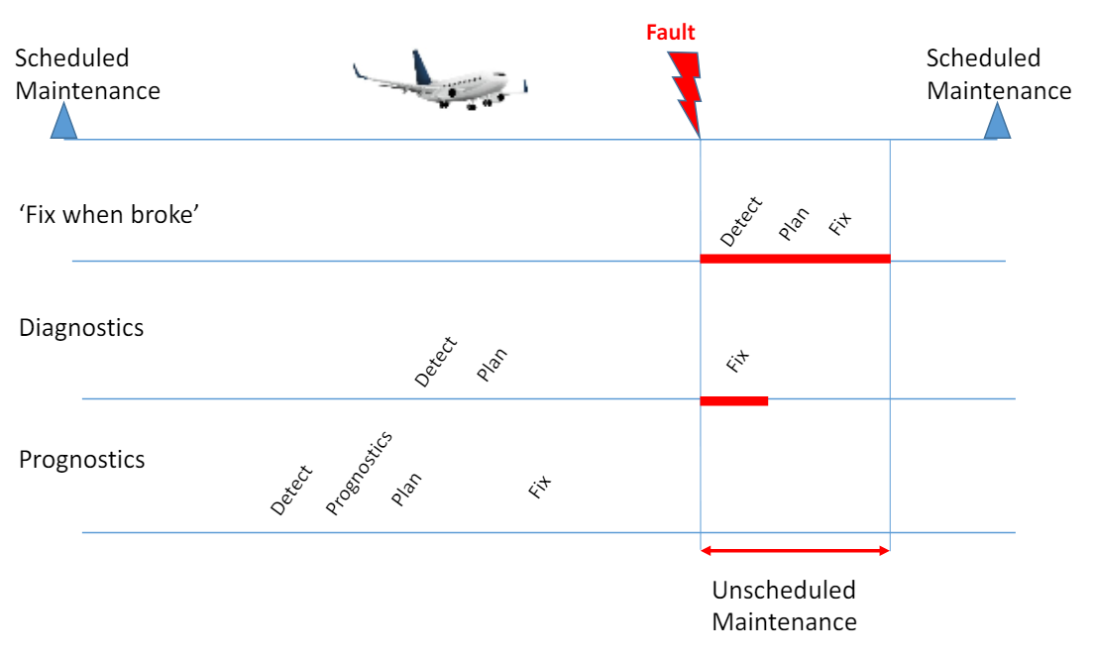
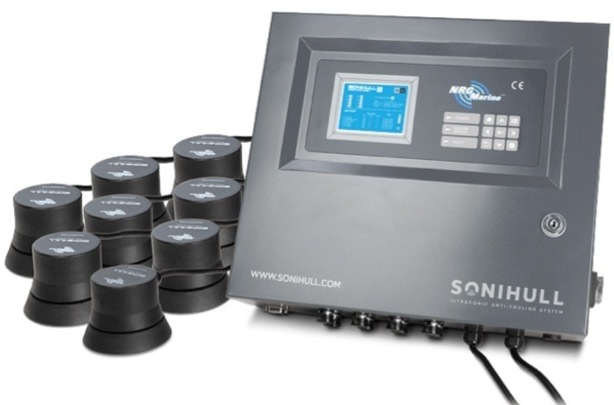
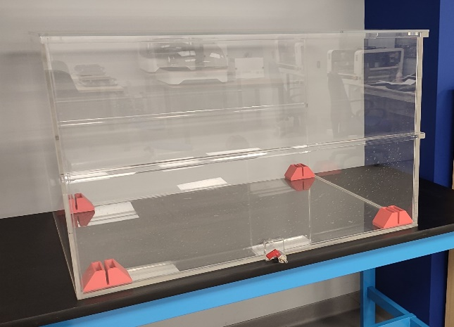
CERTH’s tasks (1/2)
Di-Pegasus project
Health status monitoring and management
Objectives
Utilize AI-based sensor data analysis post-landing for check-up, fault detection, and maintenance prediction.
Output:
Enhanced flight safety.
Reduced unscheduled maintenance.
Ultrasonic technologies for icing and biofouling mitigation
Objectives
Utilize ultrasonic and low-frequency vibrations to prevent and remove ice and biofouling.
Output:
Environmentally safe de-icing and anti-fouling strategies.
Minimized use of harmful chemicals.

Slide 16
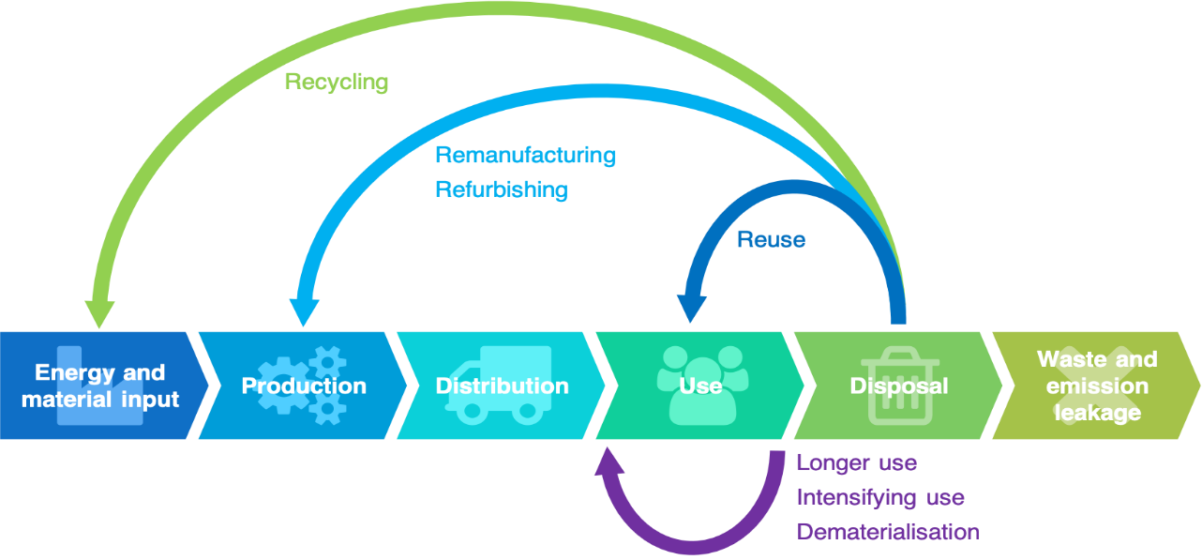
Di-Pegasus project
Sustainable circular economy framework
Objectives
Comprehensive inventory analysis of commercial aircraft and airport infrastructure materials for repurposing in UASs, vertiports and water ports, using AI, big data, data mining, analytics and IoT.
Utilization of digital tools to facilitate stakeholder collaboration for material reuse.
Output:
Enhanced sustainability.
Minimization of raw material extraction.

Slide 17
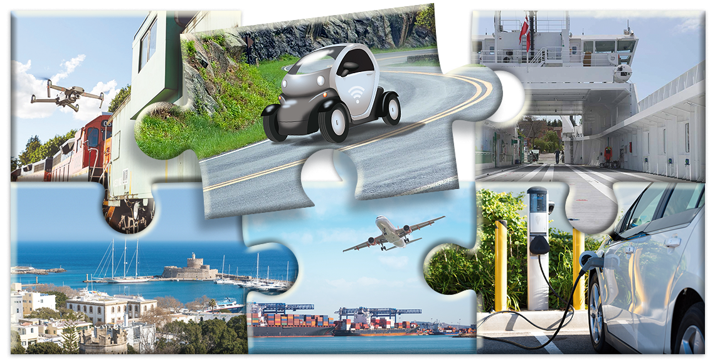
Contact Information
Dr Vassilis Kappatos
E-mail: vkappatos@certh.gr
Tel..: (+30) 2310 498 486

